Slide 1

DYNAMIC IMAGE GENERATION FROM TEXT PROMPT
TEAM ID- 662024-MI045
S. Mohsin hussain - 208R1A66G8
S. Adarsh shetty - 208R1A66G7
N. Ravi kiran - 208R1A66F7
P. Sandeep - 208R1A66F9
Guide -
Mr.B.Balakrishna
Department of Computer Science and Engineering (AI & ML)
CMR Engineering College, Hyderabad.

Slide 2
AGENDA
Introduction.
Objective.
Literature survey.
Software requirements.
System design.
Output screens
Conclusion.
Publication
References / Bibliography.

Slide 3
INTRODUCTION
Text-to-image generation is a fascinating field in AI that involves creating images from textual descriptions or prompts.
This involves converting the text input into a meaningful representation, such as a feature vector, and then using this representation to generate an image that matches the description.
This technology has the potential to revolutionize content creation, design, and a wide range of applications by automating the generation of visual content based on text.
Text-to-image generation represents the fusion of human creativity and artificial intelligence, where the imagination of human language meets the precision of machine vision, opening new frontiers in content creation and design..

Slide 4
OBJECTIVE
The primary goal of our project is to design, implement, and demonstrate a cutting-edge system capable of producing high-quality images from textual prompts.
By leveraging the power of AI models and innovative training techniques, our project aims to empower users to describe their visual ideas or concepts using text, and in response, the system will generate images that vividly and accurately depict those concepts.
Through a combination of model selection, training optimization, and creative problem-solving, we strive to push the boundaries of what text-to-image generation can achieve and set new standards in the field.

Slide 5
LITERATURE SURVEY
Text to image diffusion models are zero-shot classifiers by Kevin Clark and Priyanka Jaini.
Diffusion Models in Vision: A Survey by Florine-Alin Croitoru, Vlad Hondru, Radu Tudor Ionescu.
OpenAI. (n.d.). CLIP: Connecting Text and Images.
Radford, A., Kim, J. W., Hallacy, C., Ramesh, A., Goh, G., Agarwal, S., ... & Sutskever, I. (2021). Learning Transferable Visual Models From Natural Language Supervision.

Slide 6
SYSTEM SPECIFICATIONS
HARDWARE
Processor : CORE i3
Hard disk : 250 GB
RAM : 8 GB
SOFTWARE
Operating system : Windows 10
Programming language : Python

Slide 7
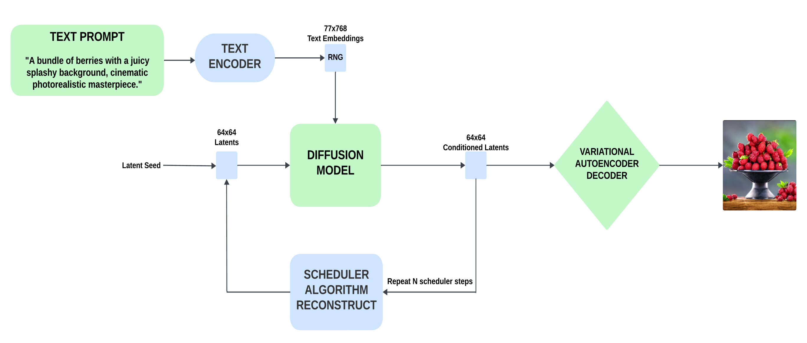
SYSTEM DESIGN

Slide 8
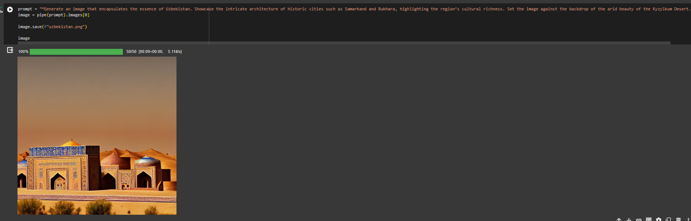
OUTPUT SCREEN

Slide 9
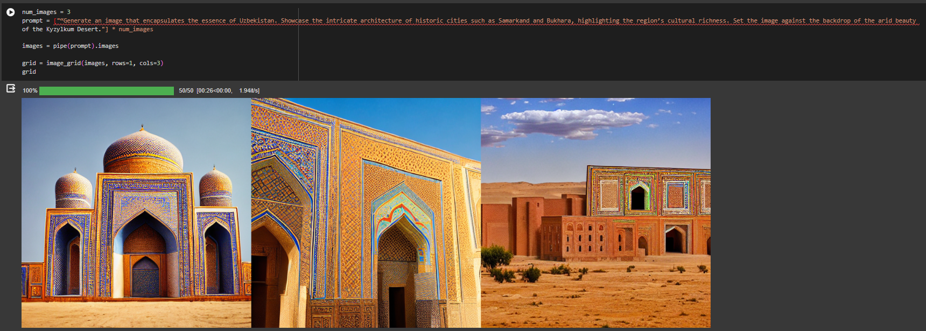
OUTPUT SCREEN

Slide 10
CONCLUSION
In conclusion, The text-to-image generation project represents a compelling convergence of natural language understanding and computer vision, showcasing the ability of AI to seamlessly bridge these two distinct fields.
The project showcases the potential of advanced deep learning techniques, such as stable diffusion, transformers, and diffusers, in creative content generation, paving the way for future innovations in the field..
The project demonstrates a significant milestone by not only aligning textual descriptions with images but also by achieving a high level of realism and context awareness in the generated visuals, indicating the potential for AI to produce visually captivating and contextually relevant images.
While the project has achieved commendable results, ongoing challenges such as fine-tuning models, enhancing diversity in generated images, and addressing ethical considerations underscore the need for continued research and development in text-to-image synthesis technology

Slide 11
PUBLICATION
Shaik Mohsin Hussain , B. Balakrishna , Palleri Sandeep, Adarsh Kumar , N. Ravi Kiran, "Dynamic Image Generation from Text Prompt ", to be published in 38th Annual Conference on Neural Information Processing Systems (NeurlPS)..

Slide 12
REFERENCES / BIBLIOGRAPHY
Chen, M., Radford, A., Child, R., Wu, J., Jun, H., Luan, D., & Amodei, D. (2021). Generating Diverse High-Fidelity Images with VQ-VAE-2. arXiv preprint arXiv:1906.00446.
J. Ho, A. Jain, and P. Abbeel, “Denoising diffusion probabilistic models,” in Proceedings of NeurIPS, vol. 33, pp. 6840–6851, 2020.
Amir Bar, Yossi Gandelsman, Trevor Darrell, Amir Globerson, and Alexei A Efros. Visual prompting via image inpainting. arXiv preprint arXiv:2209.00647, 2022.
Dhariwal, P., Nichol, A.: Diffusion models beat gans on image synthesis. Advances in Neural Information Processing Systems 34 (2021).

Slide 13
THANK YOU

